Slide 1
Whisk AI
GOOGLE LABS
Document by:
Karan Kumar

Slide 2
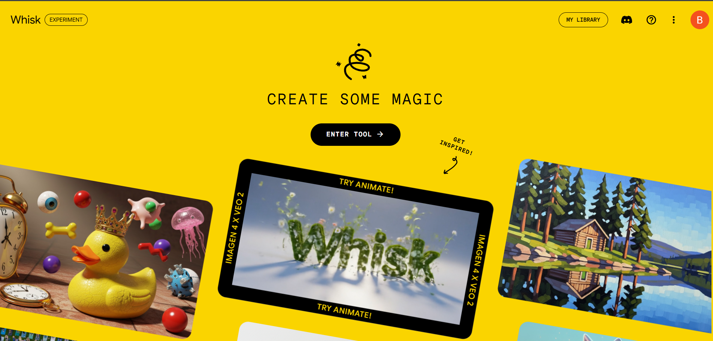
Whisk AI is currently not available in India, so I used a VPN to access its features. By connecting through a VPN

Slide 3
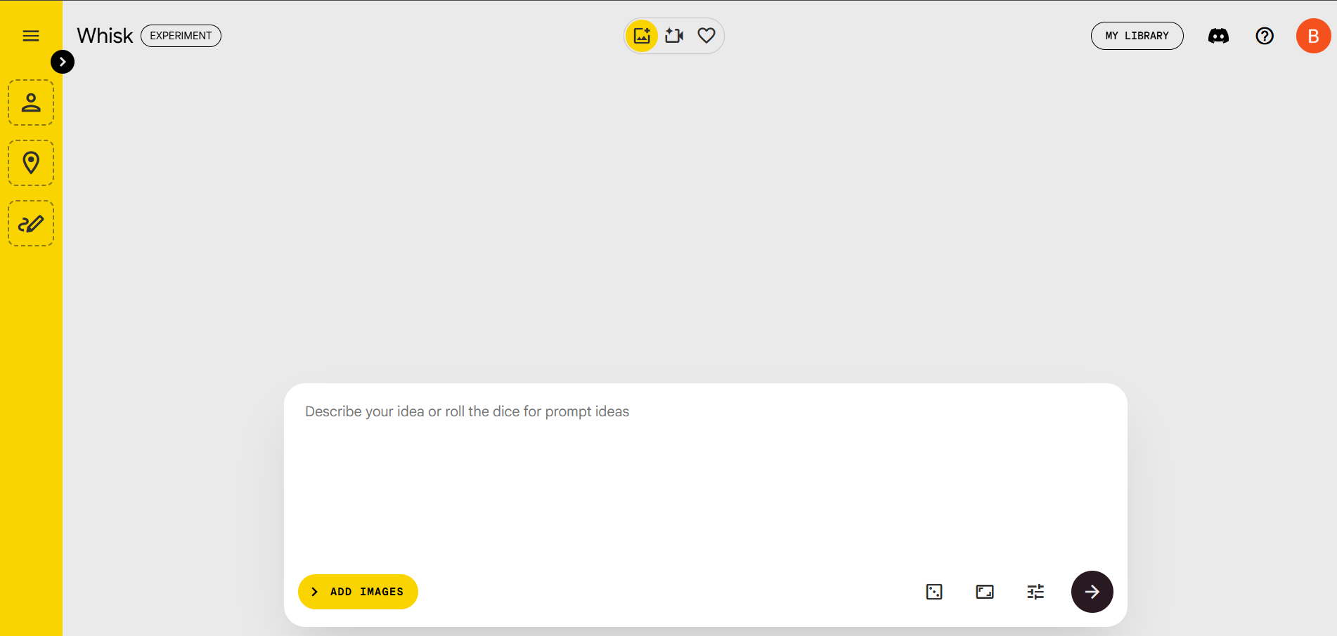
We can generated the both images and video generation in the whisk ai

Slide 4
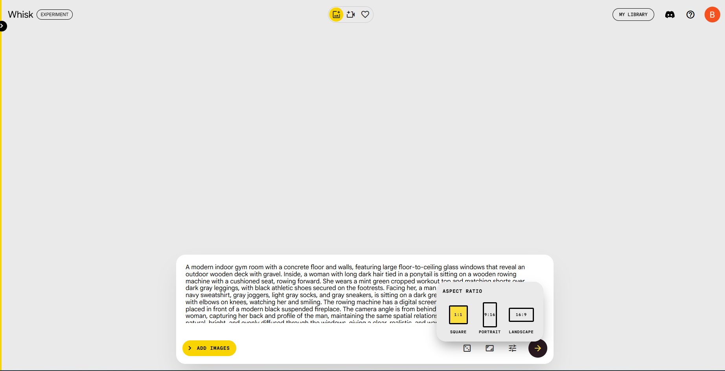
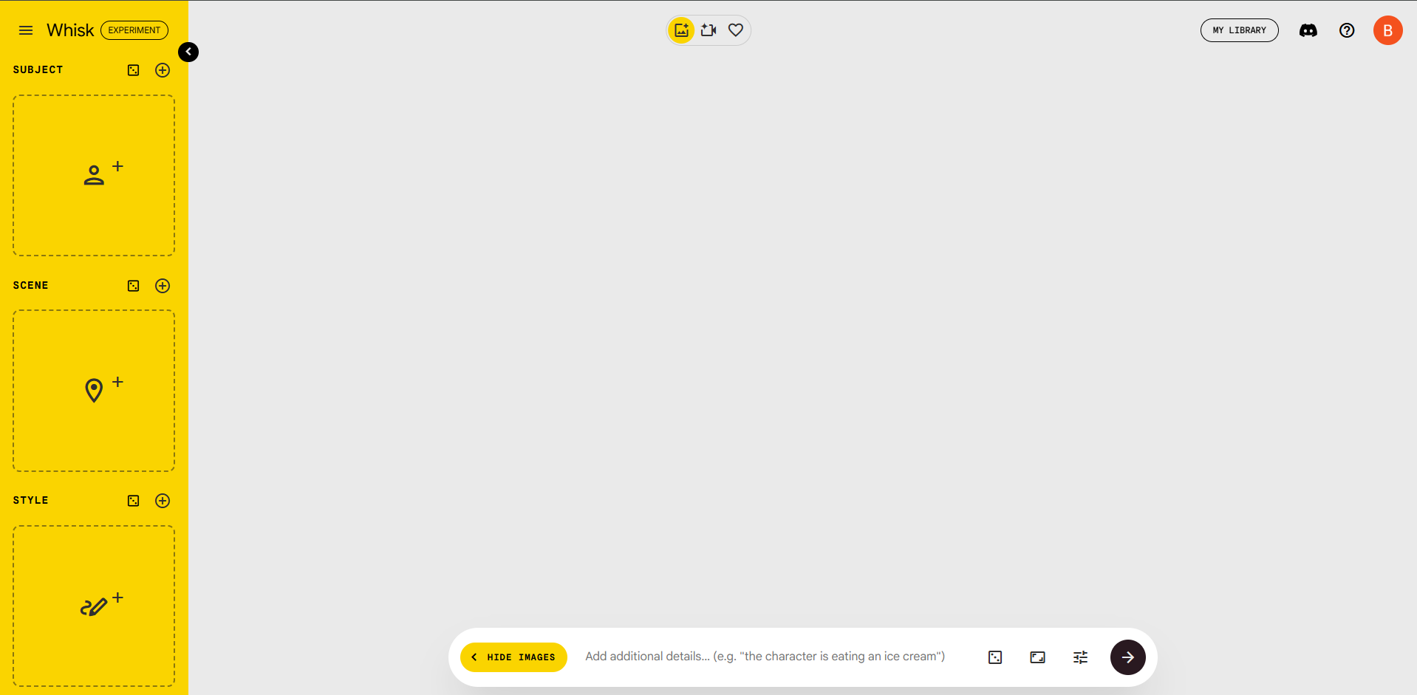
We can either provide the text prompt directly or give a scene reference using the side menu, along with specifying the background location and style also.

Slide 5
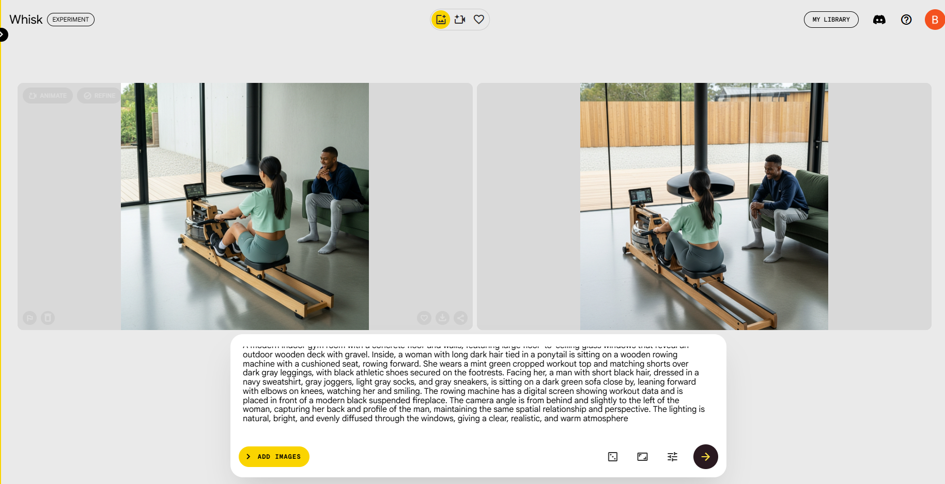
I attempted to implement AI-generated images for my task using the provided reference image as a basis for text prompts. I created many images, but the results did not match the desired camera angle. Additionally, in most generated images, the male character was not facing the display screen as in the reference; instead, he was looking at the female character’s face. To address this issue, I tried an alternative method by providing the reference image background and character separately as inputs.

Slide 6
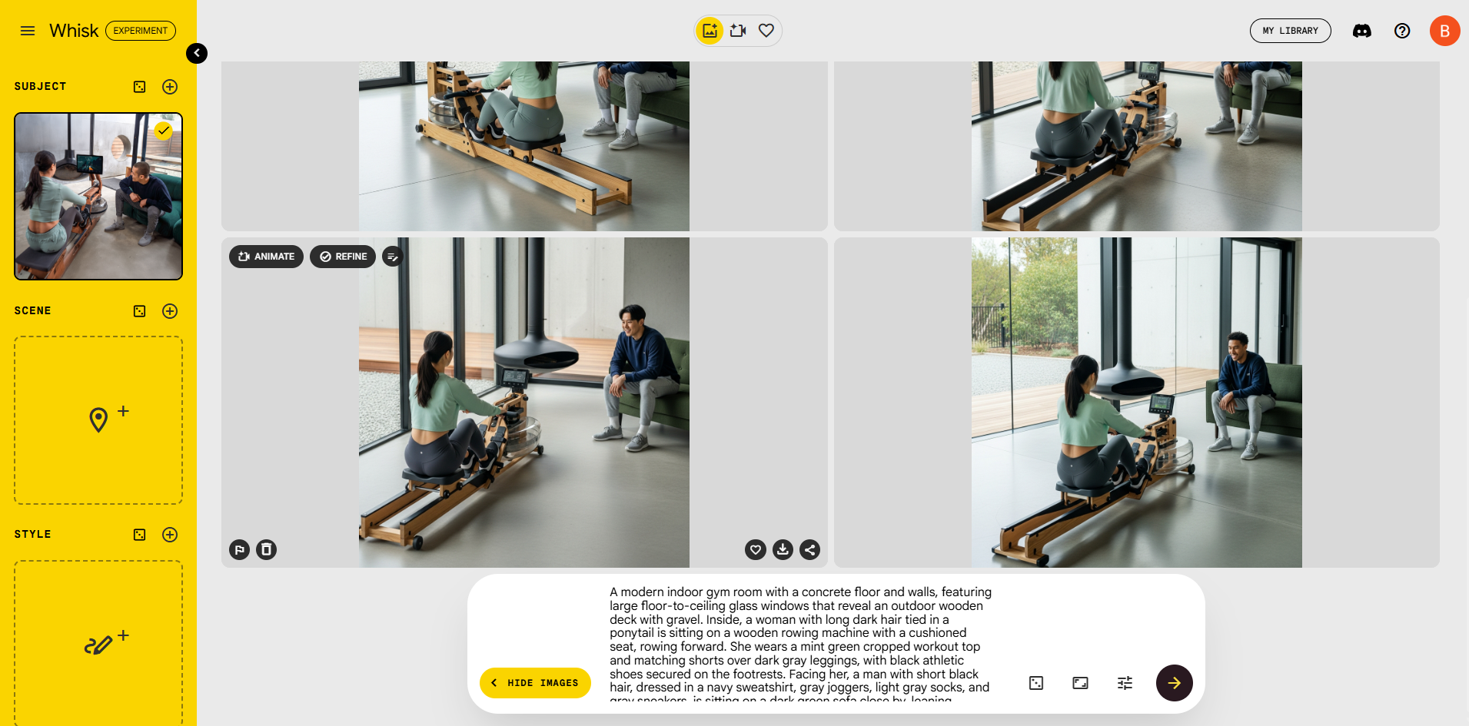
Another method I explored for image creation involves providing the reference image’s scene components separately, such as subjects, background, and locations. I tried generating images by giving these scene references individually. The resulting images appeared realistic and had a good level of detail, but the camera angle did not match exactly

Slide 7
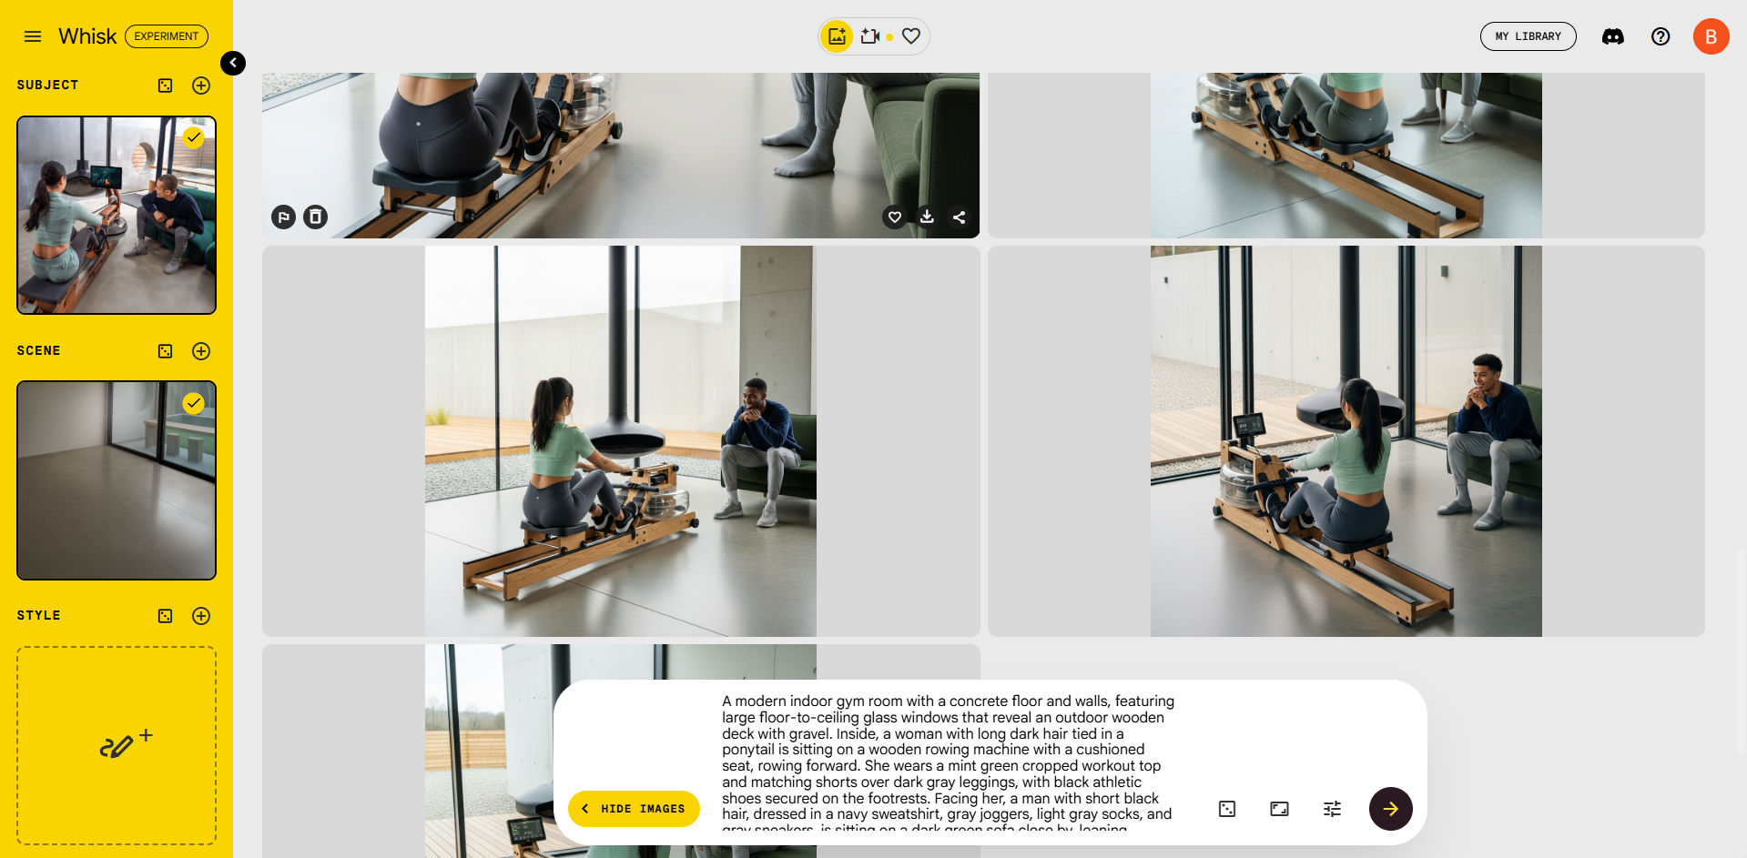
Additionally, the male character did not perfectly align with the reference character’s pose and perspective. Therefore, to improve accuracy, I also included the background scene explicitly along with the character references. This approach helped bring the composition closer to the original, but some differences in angle and character positioning remain.

Slide 8
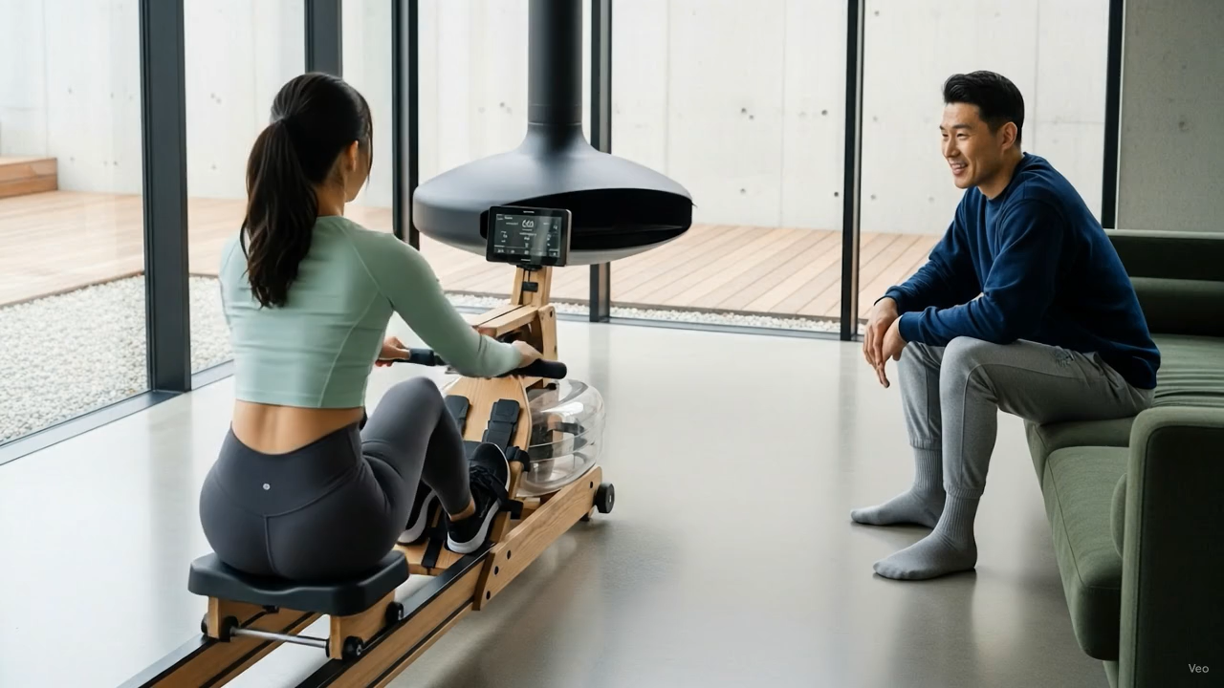
We can generate videos directly from images using its advanced image-to-video generation capabilities. It looks nice, but it is limited to only 10 generations.

